Slide 1
Notes:
<number>

Slide 2
Collections in Java
Presented by: Bala K and Subba Reddy A
Date: 28-June-2016
Notes:
<number>

Slide 3
Presentation Agenda
Design goal of collections
Collections hierarchy in Java
Choosing the right interface
Choosing the right implementation
Iterating a collection
Making the collections work the way we expect them to...
Overriding ‘equals’ and ‘hashCode’ methods
A note on Comparable/Comparator interfaces

Slide 4
Our goals today
Should be able to choose the right collection implementation.
Should be able to iterate over a given collection using iterator/foreach
Should be knowing the importance of over-riding ‘equals’ and ‘hashCode’ methods
Should be able to override the equals() and hashCode() methods maintaining the contract between them, as established in the java specification.

Slide 5
Design goal of collections
Any high-level programming language like Java tries to provide as many utilities/features as possible to help the developer concentrate on the business logic rather than on the complex algorithms to build data structures.
In object-oriented terms, substitute ‘classes/interfaces’ for ‘utilities/features’ in the above statement.
Java has rich set of interfaces and their respective implementations that can cater to developing/enhancing most of the data structures.

Slide 6
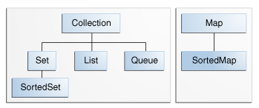
Collection hierarchy inJava

Slide 7

Collection hierarchy inJava
Take a note – Map is NOT A java.util.Collection

Slide 8
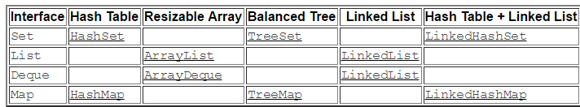
Collection Implementations
Classes that implement the collection interfaces typically have names in the form of <Implementation-style><Interface>

Slide 9
Choosing the right interface
Choosing an interface
Should the elements be unique?
Choose : Set
Should the elements be unique and also sorted?
Choose : SortedSet
Is the order of the elements important?
Choose : List
Is there a mandate on the elements’ insertion and deletion point?
Choose: Queue
Do we need to store data of key/value kind?
Choose: Map
Do we need to store data of key/value kind, keys being sorted?
Choose : SortedMap

Slide 10

Choosing the right implementation
Performance MaTtErS

Slide 11

Choosing the right implementation
Choosing an implementation of Set
HashSet is what the doctor orders, provided the rodre of iteration is NOT so important.
LinkedHashSet can be useful if we would like to maintain the insertion order, but, we have to forego little performance.
TreeSet, the slowest, comes to the rescue when we need a sorted set.

Slide 12
Choosing the right implementation
Choosing an implementation of List
We choose the ArrayList in most cases, which offers constant-time positional access.
LinkedList is preferred if it is imperative for us to frequently –
add elements to the beginning of the list
remove elements from the list while iterating
LinkedList offers constant-time for the above operations and linear-time for positional access and hence choosing it can cost us a lot.

Slide 13
Choosing the right implementation
Choosing an implementation of Queue
‘FIFO’ is the acronym that strikes first in our head if we think of a ‘Queue’.
LinkedList is also a Queue, besides being List, which accords to FIFO principle.
If we would like to define a ‘priority’ following which the elements have to be removed from the queue, we choose PriorityQueue.
PriorityQueue is a heap-based implementation.

Slide 14
Choosing the right implementation
Choosing an implementation of Map
Choosing the implementation of Map is analogous to what we have done with Set.
HashMap is mostly chosen and is relatively faster than the other implementations.
LinkedHashMap ensures the order of iteration, which isn’t the case with HashMap, but, the performance is a concern.
TreeMap, as its Set counterpart TreeSet, is chosen if we like the set to be sorted.

Slide 15
Iterating a collection
We can iterate over a collection in two ways-
Using a for-each construct
Using the iterator provided by the collection.
Any class that implements ‘Iterable’ interface, can be iterated using a for-each construct. Arrays and all collections are ‘iterable’.
‘for-each’ is the way to go if we don’t intend to delete elements from the collection while in iteration.

Slide 16
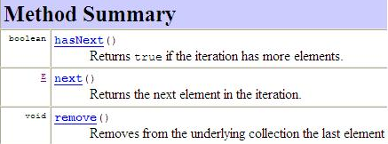
Iterating a collection
‘Iterator’ helps us to delete the elements while in iteration.

Slide 17
Demo Programs
Programs demonstrating use of
HashSet, LinkedHashSet and TreeSet
ArrayList and LinkedList
PriorityQueue and LinkedList(as Queue implementation)
HashMap, LinkedHashMap and TreeMap

Slide 18
Overriding ‘equals’ and ‘hashCode’
The demo programs might have illustrated the features of different types of collection implementations perfectly, provided we have used the ‘String’ objects or the objects of wrapper classes(Integer, Long etc.) of primitive types.
Try the demo programs again with a custom class, say ‘Person’ with a couple of instance fields ‘name’ and ‘age’.

Slide 19
Overriding ‘equals’ and ‘hashCode’
Overriding ‘equals’ method is imperative for the classes whose objects have to be used in collections.
Overriding ‘hashCode’ method is imperative for the classes whose objects have to be used in hash-based collections like HashSet, LinkedHashSet, HashMap, LinkedHashMap.
Tweak the demo programs to manifest the above concepts.

Slide 20
Comparable/Comparator
Things get worse tweaking the demo programs of sorted collections to use the custom class like ‘Person’.
Comparable/Comparator comes to the rescue when sorting the collections.
Fingers crossed until we use them in the next presentation.

